Slide 1
“Supply Chain Management”
Presented by: Abeera Nayyer Roll no: Bscs-f19-m53 Section: B-Morning

Slide 2

Supply chain which represents a “ network of organizations that are involved, through upstream and downstream linkages, in the different processes, softwares and activities that produce value in the form of products and services in the hands of the consumer.
Introduction
A supply chain is the alignment of firms that brings products, softwares or services to market.
In a narrow sense the term supply chain is also applied to a large company with several sites often located in different countries.

Slide 3
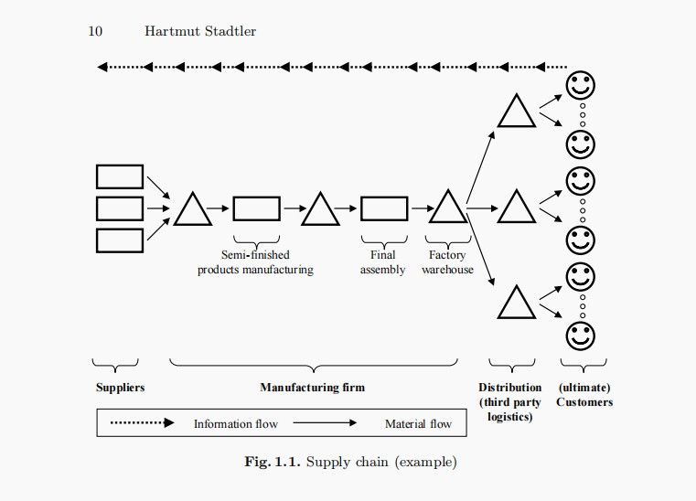
Supply Chain
management

Slide 4
Year | Author | Method | Conclusion
2001 | John T. Mentzer | “Beer Game” Simulation and research covering the “Bullwhip Effect” . | Without a clear understanding of SCM, we cannot expect wide application of SCM in practice or research. The goals of SCM—lower costs, increased customer value and satisfaction, and ultimately advantage
2018 | Beau Woods and Andy Bochman | COTS hardware and software, procured against a standard set of requirements, with a standard set of components. | This research outlines a taxonomy for understanding certain energy sector risks, such as unintended taint, and defines concrete and exploratory recommendations for equipping policy makers and the private sector
1995 |  |  | Using SCM as an organiZational core strategic tool will help boost agribusiness performances to remain and sustain competitive edge over rivals
 | Michael Kwamega | Data amassed from selected agribusiness ﬁrms from the Northern Region of Ghana. Statistical Package for Social Sciences 22.0 version and LISREL 8.0 were used to test hypotheses on the nexus. .

Slide 5
Analysis
A systems approach to viewing the supply chain as a whole, and to managing the total flow of goods inventory from the supplier to the ultimate customer;
Astrategic orientation toward cooperative efforts to synchronize and converge intrafirm and interfirm operational and strategic capabilities into a unified whole; and
Acustomer focus to create unique and individualized sources of customer value, leading to customer satisfaction

Slide 6
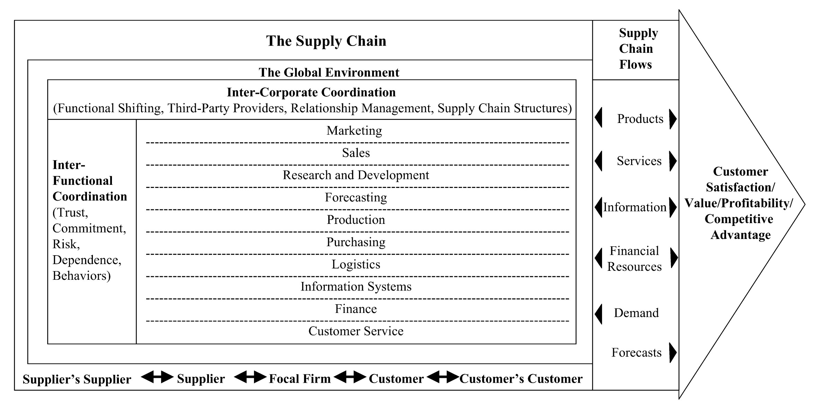

Slide 7
Conclusion
Supply Chain Management streamlines the flow of everything from goods to any unexpected natural disaster. Globally, every organization’s logistics are managed by supply chain managers. With effective supply chain management, supply chain managers can easily diagnose problems/disruptions for seamless movement of goods.
Reduced overall operating costs.
Consequently, an efficient supply chain helps minimize delays, which is crucial for maintaining financial efficiency and efficacy.
With SCM in place, visibility & transparency across every stage of the supply chain is increased. It helps create opportunities for the workforce across various departments to collaborate and make informed decisions.

